Slide 1
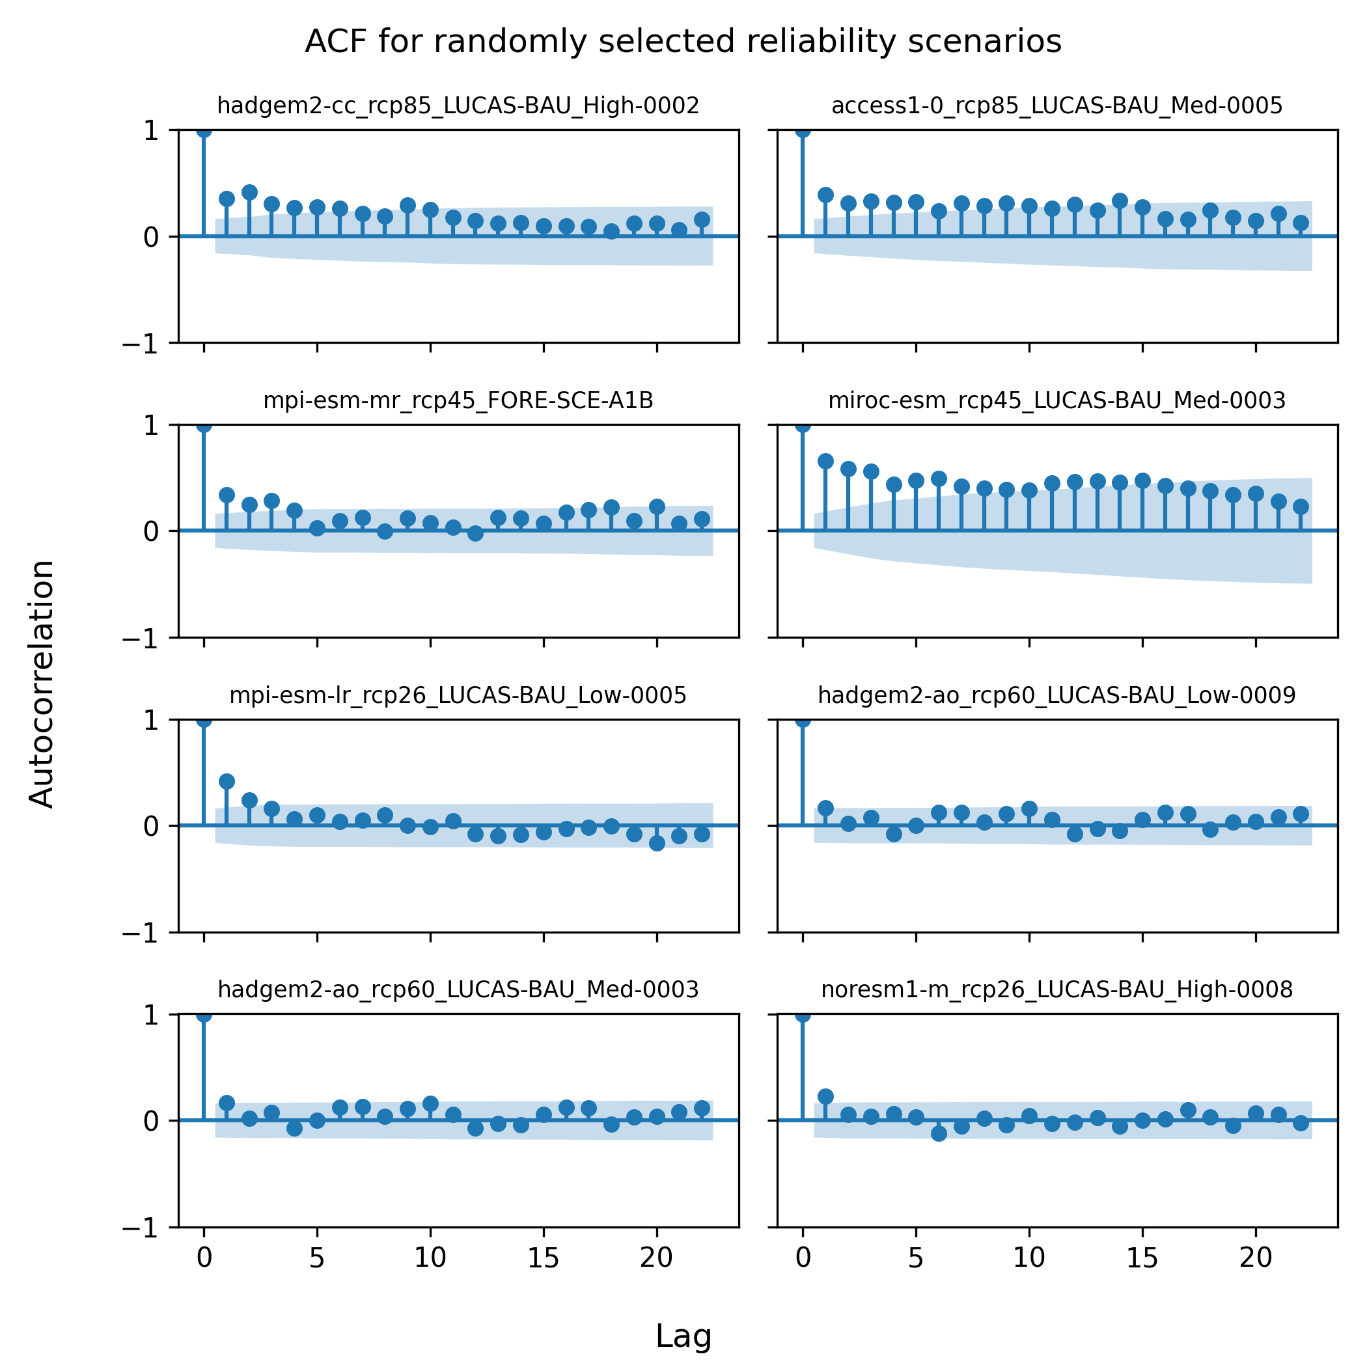
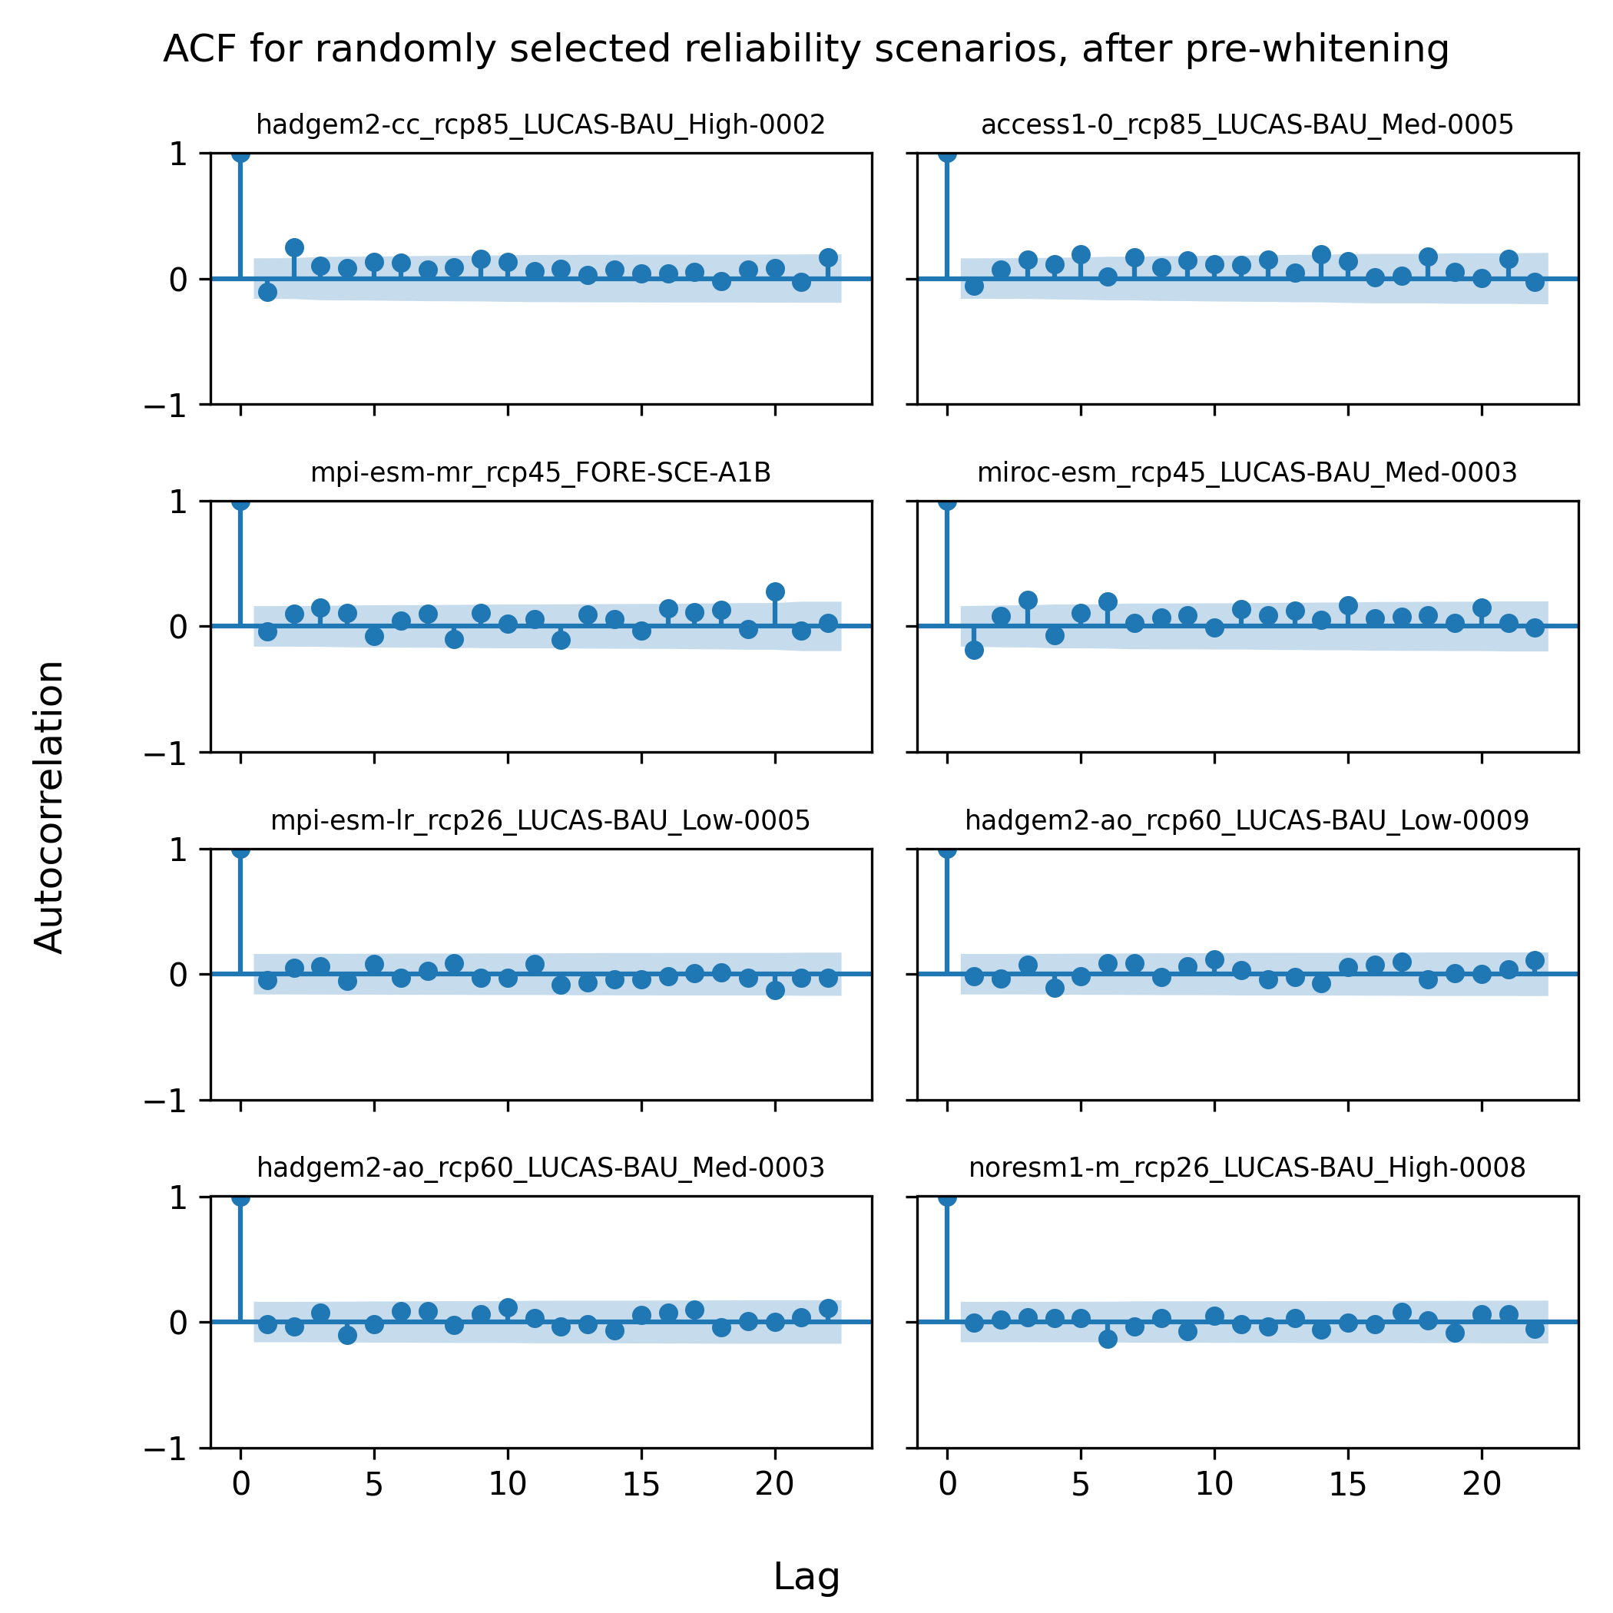
ACF for randomly selected reliability scenarios
No pre-whitening
With pre-whitening

